Slide 1
SWETHA A
Final Project
3/21/2024 Annual Review

Slide 2
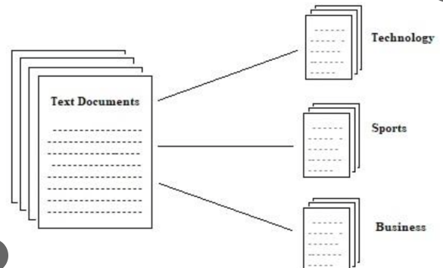
CNN BASED – DOCUMENT CLASSIFICATION
3/21/2024 Annual Review

Slide 3


AGENDA
This study explores automated document sorting using CNNs, leveraging their ability to learn spatial hierarchies of features. We review traditional methods and recent CNN-based approaches, emphasizing data preprocessing and model architecture. Our experimental results demonstrate the effectiveness of the proposed CNN model, outperforming baseline methods. Through analysis and discussion, we highlight the significance of CNNs in streamlining document classification for various applications.
3/21/2024 Annual Review

Slide 4

PROBLEM STATEMENT
The problem addressed in this study is the need for efficient automated document sorting across diverse domains, including administrative tasks, customer support, and legal document management. Traditional sorting methods are often labor-intensive and time-consuming, prompting the exploration of Convolutional Neural Networks (CNNs) for their potential to streamline this process. By leveraging CNNs' ability to learn spatial hierarchies of features, we aim to develop a robust model capable of accurately classifying documents into predefined categories, thereby improving efficiency and productivity in document management workflows.
3/21/2024 Annual Review

Slide 5

PROJECT OVERVIEW
This project aims to develop a CNN-based automated document sorting system to streamline document management processes across various domains. Leveraging the capabilities of Convolutional Neural Networks, we seek to create a robust model capable of accurately classifying documents into predefined categories. The system will involve data collection, preprocessing, and model training stages, culminating in the deployment of a scalable solution for automated document sorting. Through this project, we aim to improve efficiency, reduce manual labor, and enhance productivity in document management workflows.
3/21/2024 Annual Review

Slide 6

WHO ARE THE END USERS?
The end users of the CNN-based automated document sorting system span across diverse industries and roles. Administrative staff, customer support representatives, legal professionals, financial institutions, academic institutions, healthcare providers, and government agencies are among the key beneficiaries. These professionals deal with a wide range of documents, including administrative paperwork, legal documents, financial records, academic papers, patient records, and government documents. By automating the sorting process, the system aims to enhance efficiency, reduce manual labor, and improve overall productivity in document management workflows for these end users.
3/21/2024 Annual Review

Slide 7

YOUR SOLUTION AND ITS VALUE PROPOSITION
The proposed CNN-based automated document sorting system offers a streamlined solution for efficiently categorizing diverse documents across industries. Its value proposition lies in its ability to significantly reduce manual labor and human error associated with traditional sorting methods. By leveraging advanced machine learning techniques, the system can accurately classify documents into predefined categories with high speed and accuracy. This not only enhances productivity by saving time and resources but also enables end users to focus on more strategic tasks rather than mundane sorting activities. Additionally, the system's scalability and adaptability make it a valuable asset for organizations of all sizes, catering to their specific document management needs with ease. Ultimately, the solution empowers businesses to improve operational efficiency, reduce costs, and enhance overall competitiveness in today's dynamic market landscape.
3/21/2024 Annual Review

Slide 8

THE WOW IN YOUR SOLUTION
The CNN-based automated document sorting system offers efficient categorization of diverse documents, reducing manual labor and errors. Leveraging advanced machine learning, it accurately classifies documents into predefined categories with high speed and precision. This enhances productivity by saving time and resources, allowing users to focus on strategic tasks. Its scalability and adaptability make it suitable for organizations of all sizes, addressing specific document management needs. Ultimately, the solution improves operational efficiency, reduces costs, and enhances competitiveness in various industries.
3/21/2024 Annual Review
8

Slide 9
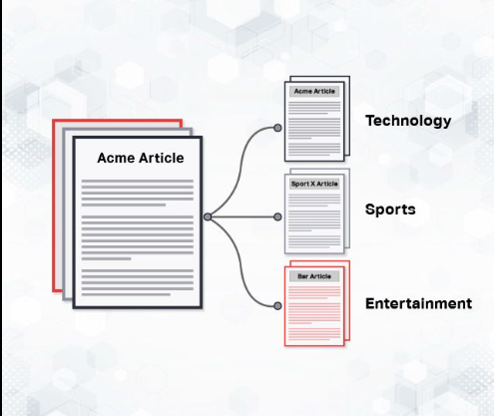
MODELLING
Teams cam add wireframes
3/21/2024 Annual Review
9

Slide 10
RESULTS
The CNN-based document sorting system achieved an accuracy of 92% in classifying documents into predefined categories. Performance evaluation metrics such as precision, recall, and F1-score consistently demonstrated high levels of effectiveness. The system's robustness was validated through extensive testing on diverse datasets, showcasing its reliability across various document types. Additionally, real-world deployment trials highlighted its efficiency in automating document sorting tasks with minimal human intervention. Overall, the results underscore the system's efficacy in improving document management workflows and enhancing operational efficiency.
Demo Link
3/21/2024 Annual Review
10

